Slide 1
Microbial Dark Matter
Greg Gloor
U. Western Ontario
Department of Biochemistry
ggloor@uwo.ca : @gbgloor

Slide 2
My checkered past
1980s – transposition ( Mu (in-vitro), P(chromatin) )
Second in-vitro demonstration ↑ ~100X, Cut & Paste
1990s – DSB repair
SDSA
2000s – DSB repair, DNA computing
2006 – Protein coevolution
MiP phylogenetic correction
2010s – Microbiomes, CoDa
Combinatorial barcoding, MTome
2020s – Eclectic
Synbio, bird microbiomes, waste water, ML
Notes:
Many more fragments than we can count

Slide 3

The big goal
Given a metatranscriptome dataset:
Identify taxa that are driving difference between groups
Identify genes that contribute to that difference regardless of taxa
Identify functional differences
Ideally analyses are internally consistent
Notes:
Many more fragments than we can count

Slide 4
Why is this hard (part 1a)?
Moving and missing parts
Species can:
==
∆ abundance
∆ occurrence
Genes can:
==
∆ abundance
∆ occurrence
Dark matter
No genomes
No annotations
Notes:
Many more fragments than we can count

Slide 5
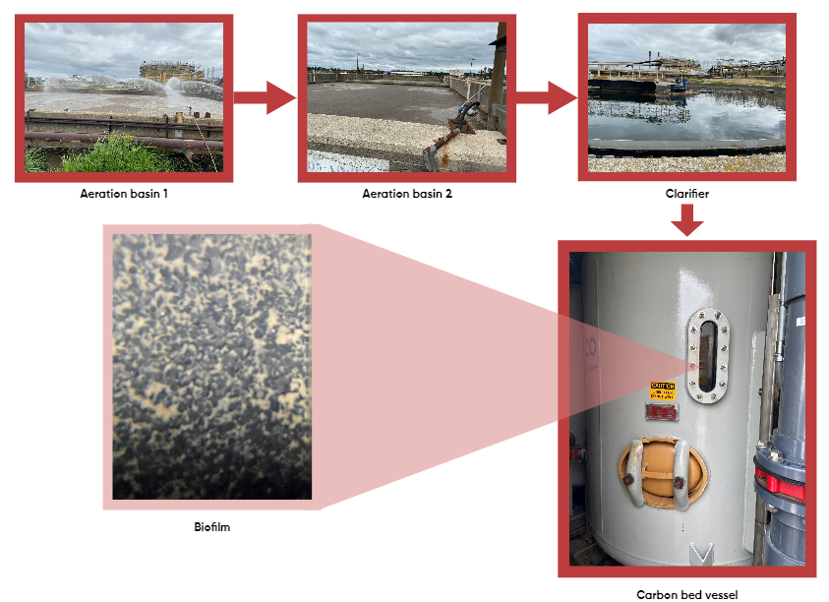
Example Ecosystem
GAC bed at Suncor refinery
Concentrates NA
Biofilm
Degrades
Fouls
Annotate to Class or Order only
Lots of novelty

Slide 6
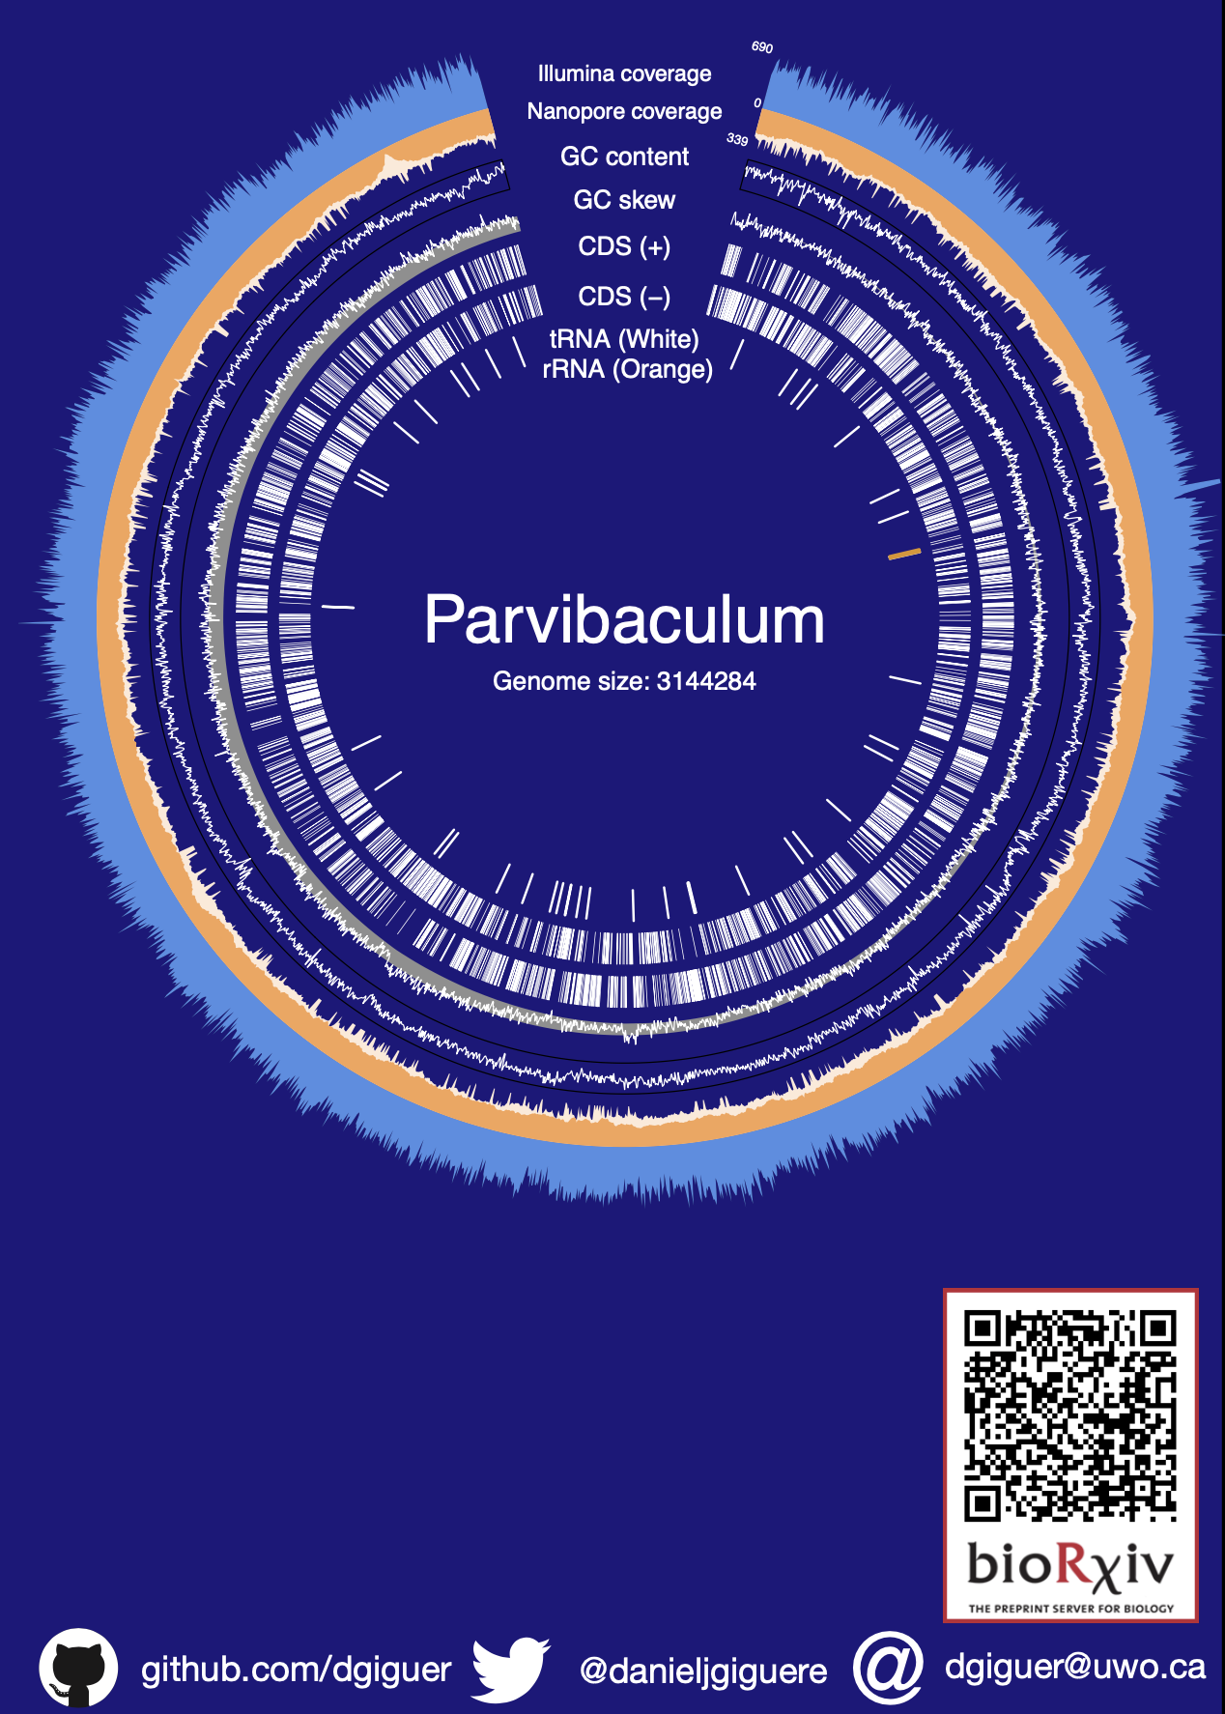
Complete genomes from ONP
~10-12 Closed genomes/sample
~60% of reads
Novel filtering method Gerenuq
‘6 lines of AWK’
Essentially HQD
Hundreds of small circles
~30% of reads
Basically un-annotatable

Slide 7
Annotation
Sequence-based
Sequence homology finding (FAST)
Usually with protein families
Hypothesis of structural positional homology
Structure-based
Structure homology finding (S L O W)
Structures need to be available
More direct test of positional homology

Slide 8
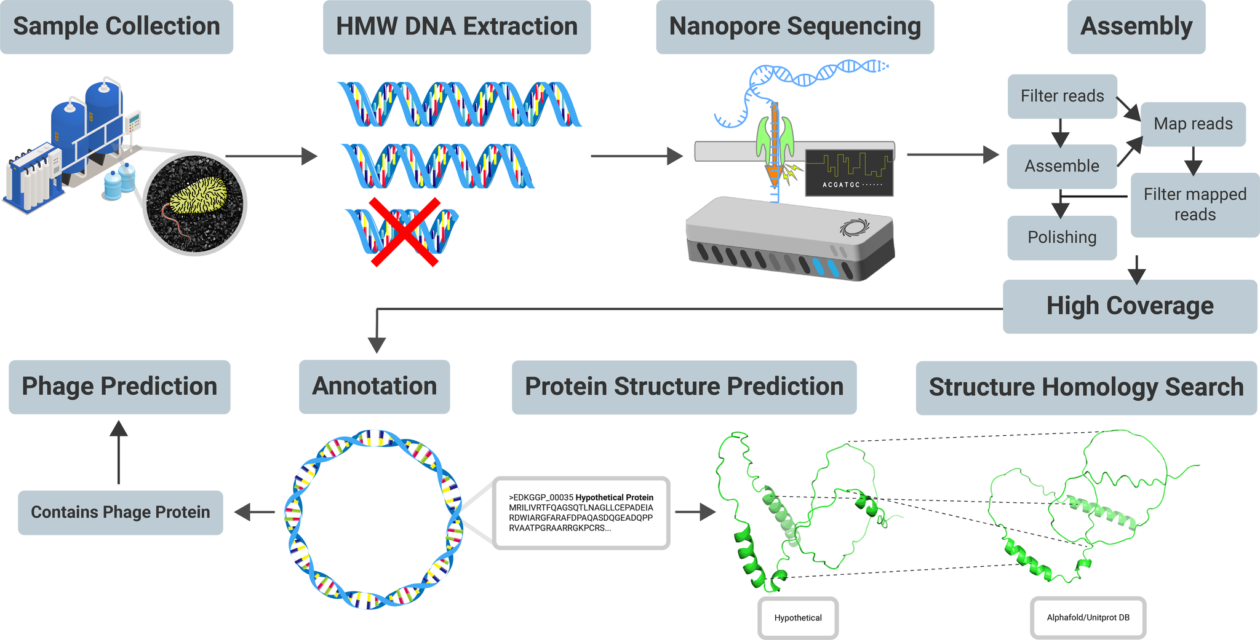
Workflow
Dan Giguere, Ben Joris, Alex Bahchelli, Henry Say
(AlphaFold, Martin Steinegger CoLabFold & FoldSeek)

Slide 9
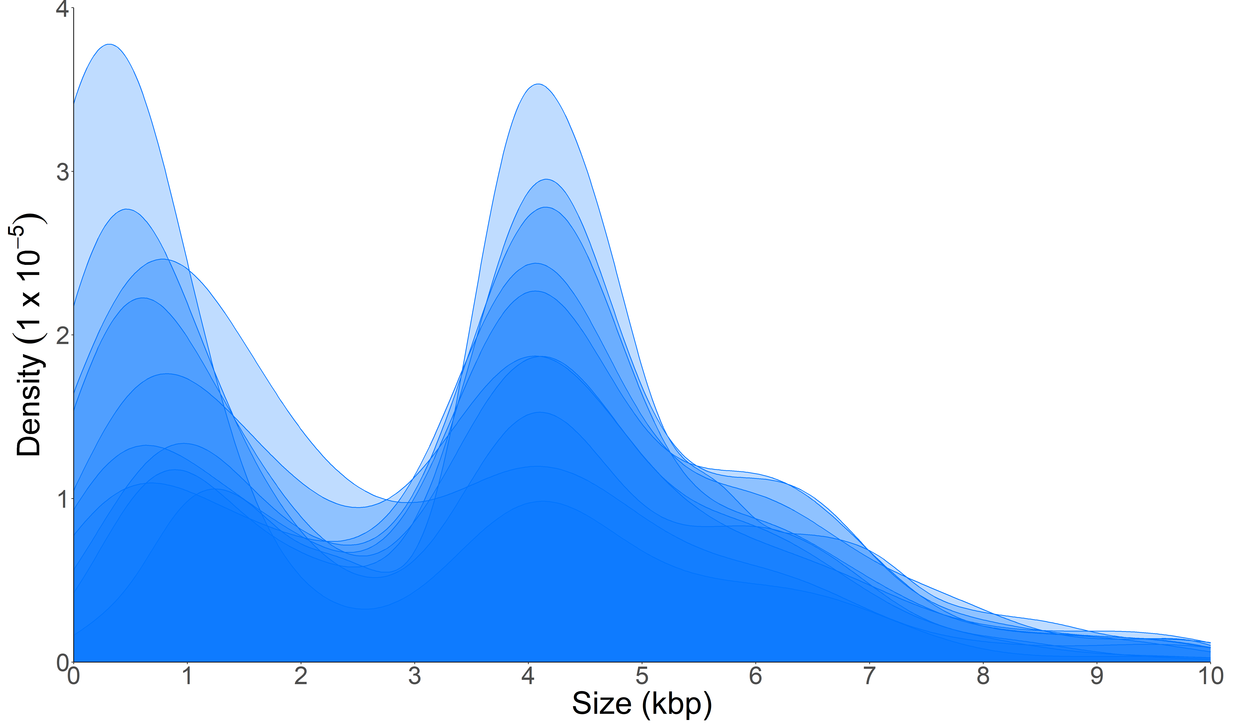
Sub-genomic circle sizes distributions
Henry Say

Slide 10
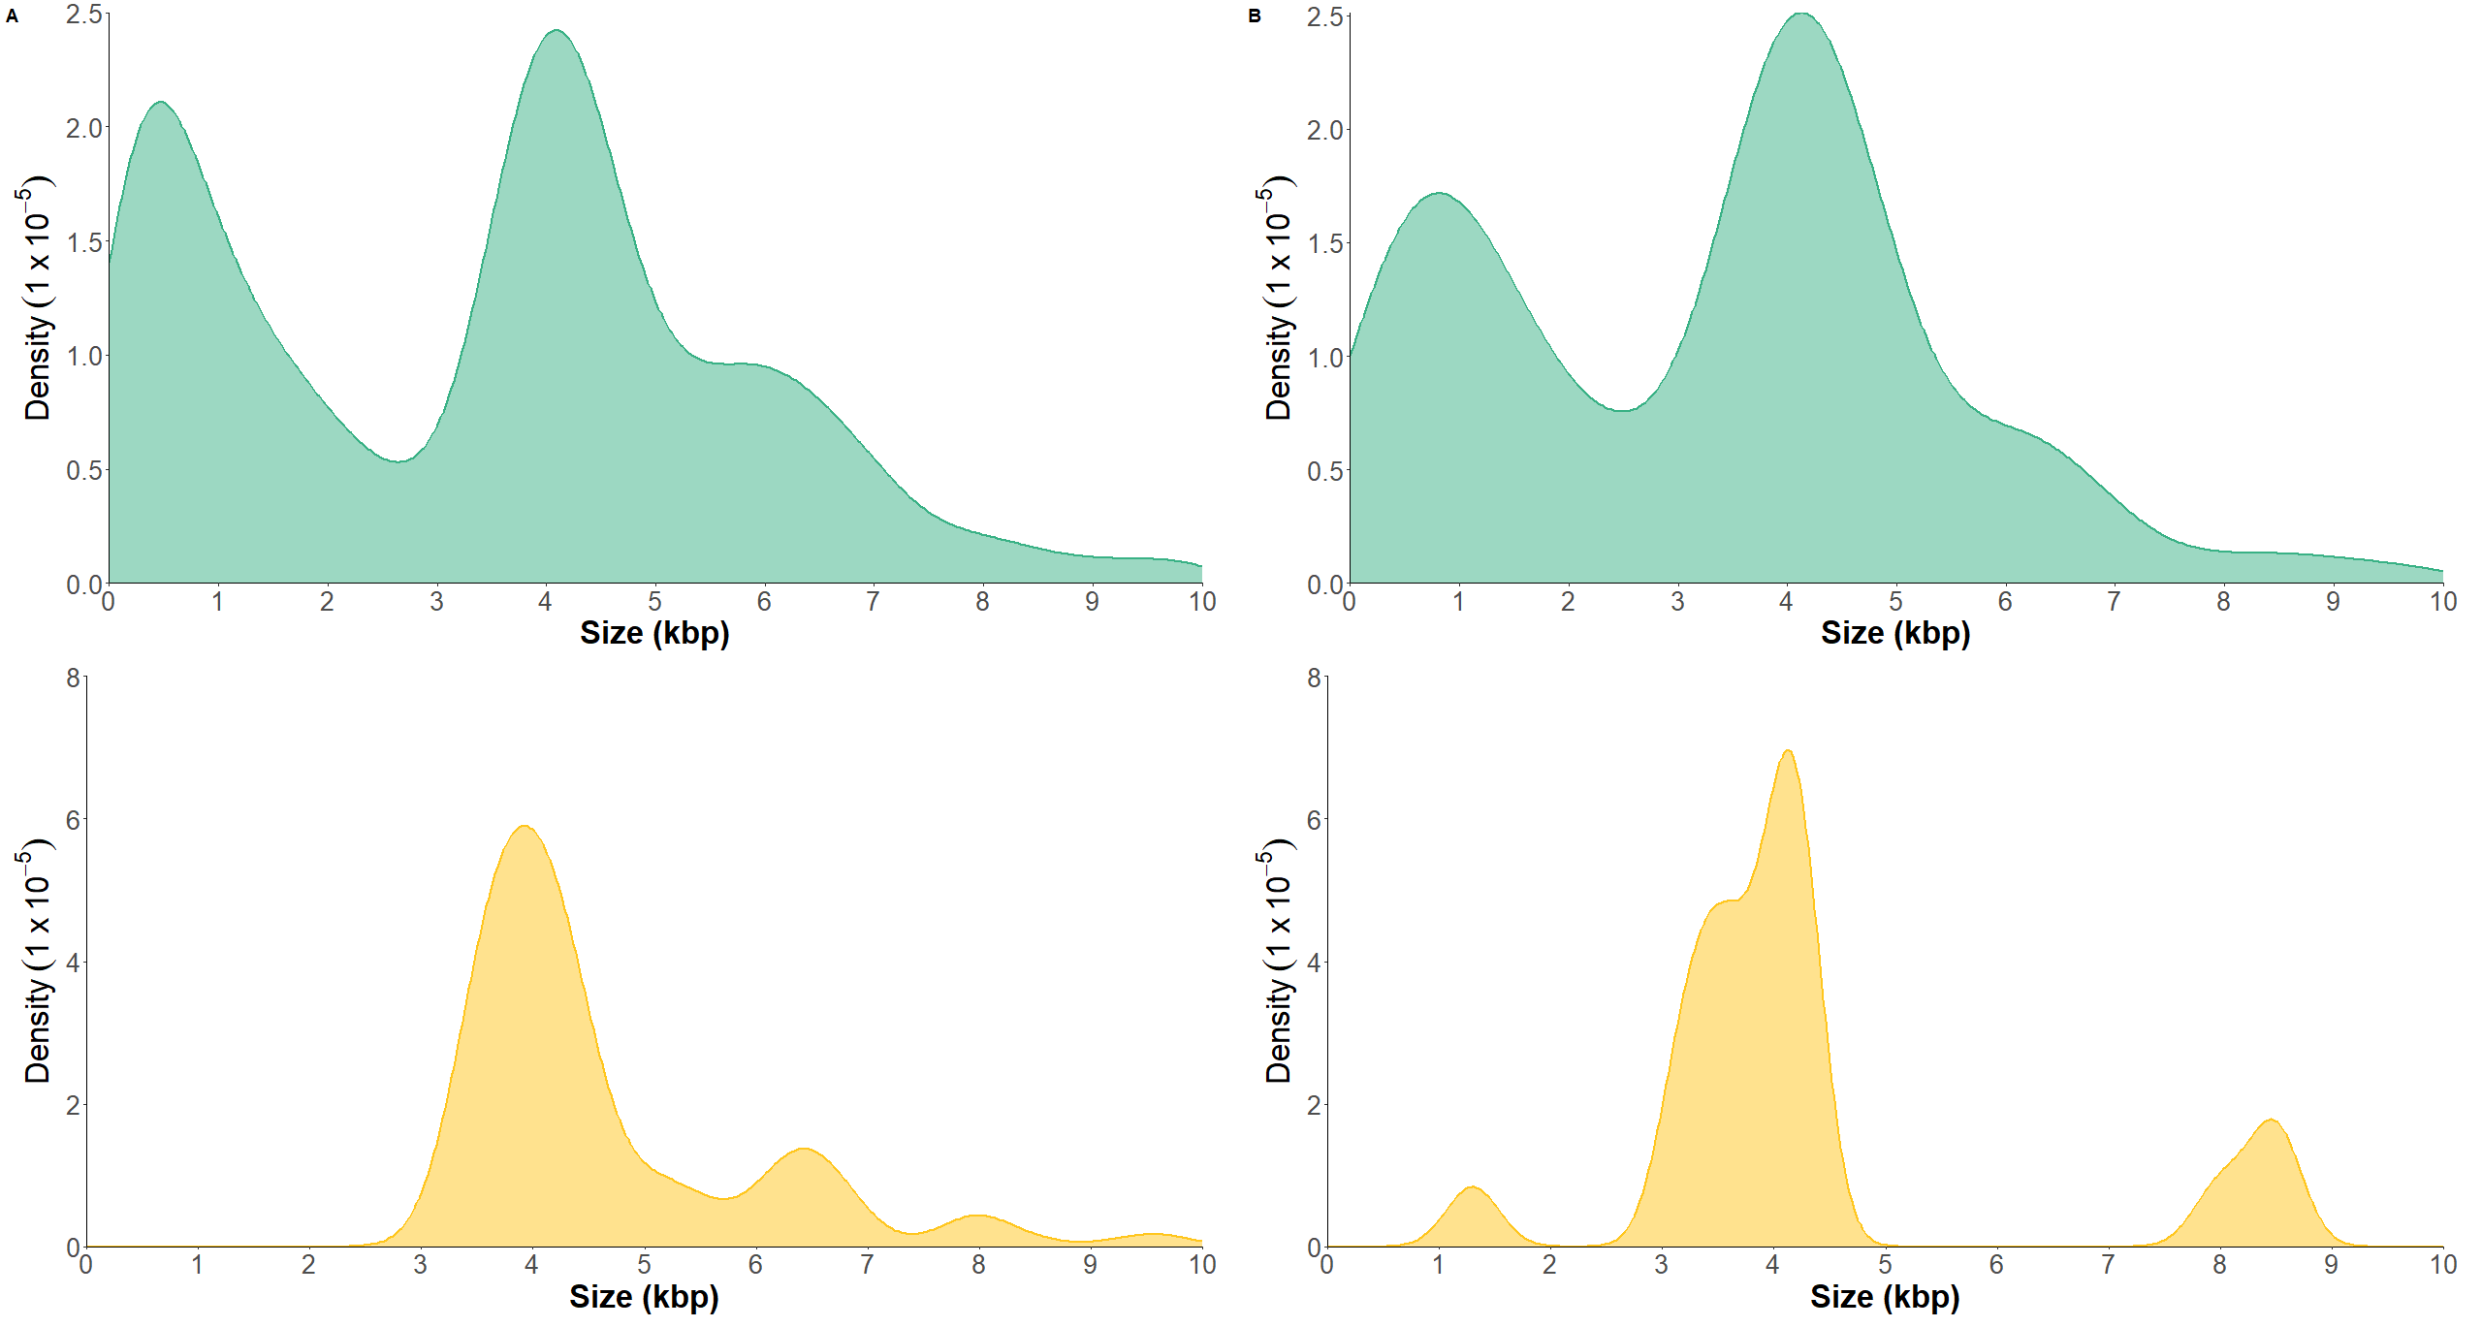
One sample and phage
Henry Say

Slide 11
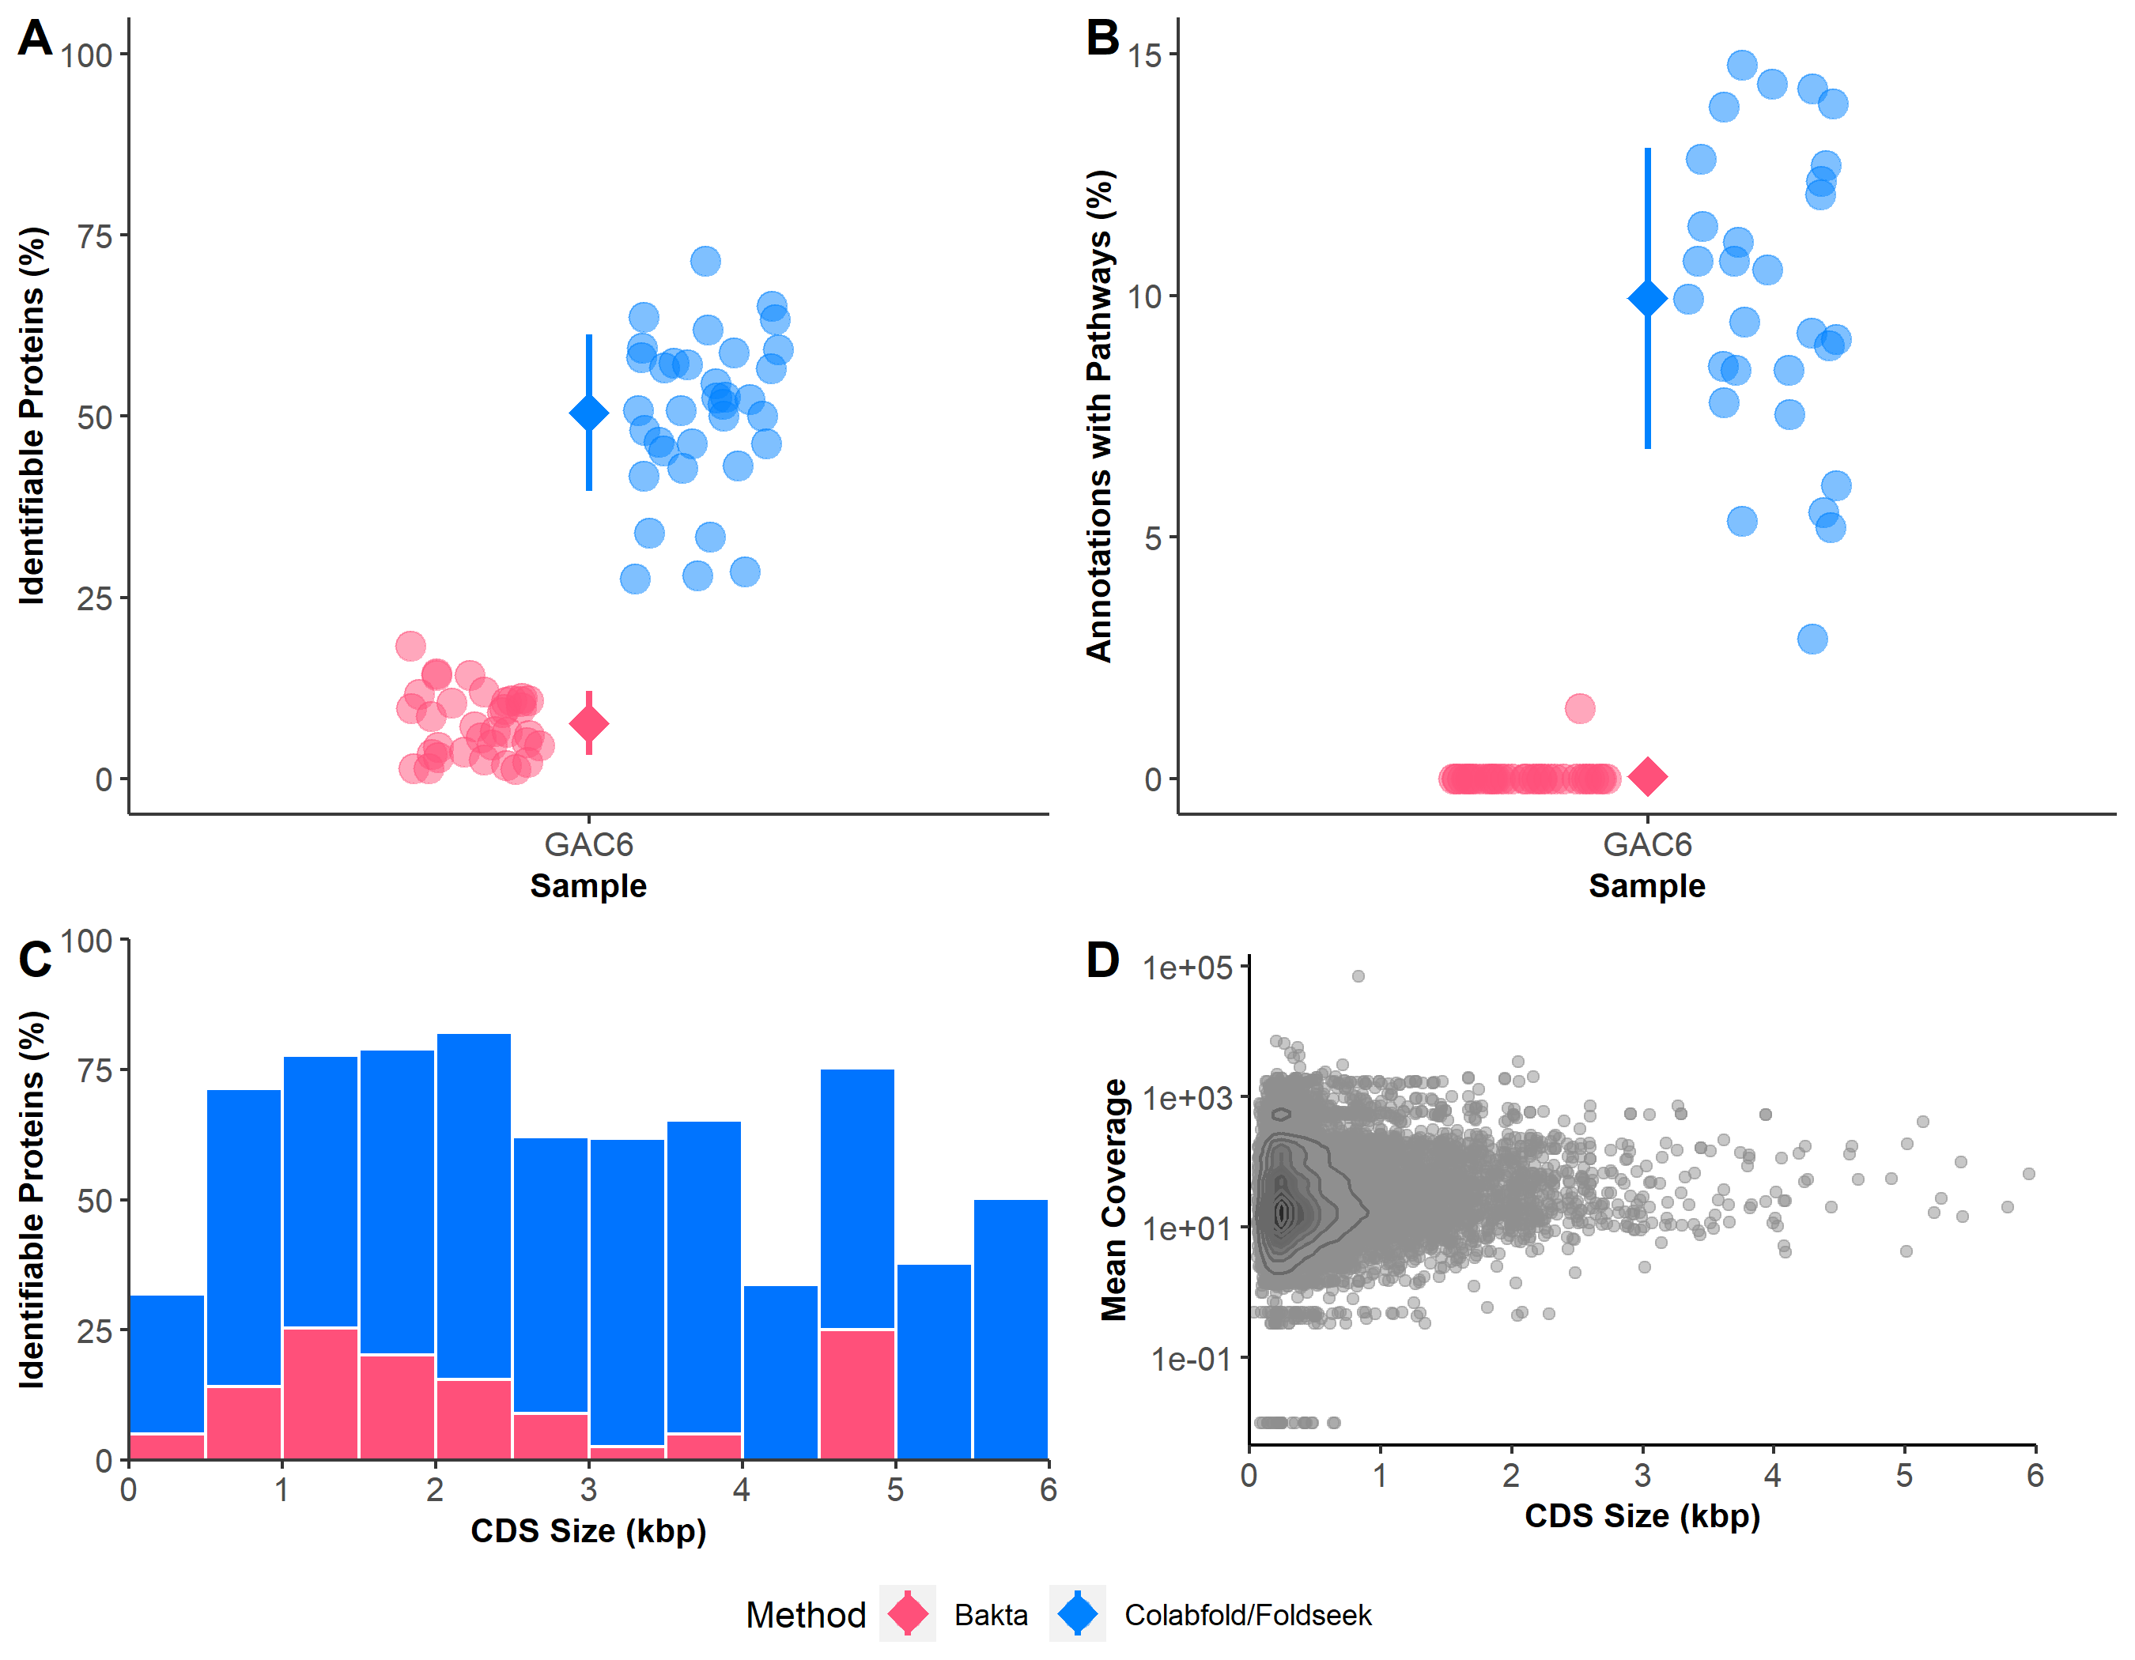
ColabFold & Foldseek
Henry Say

Slide 12
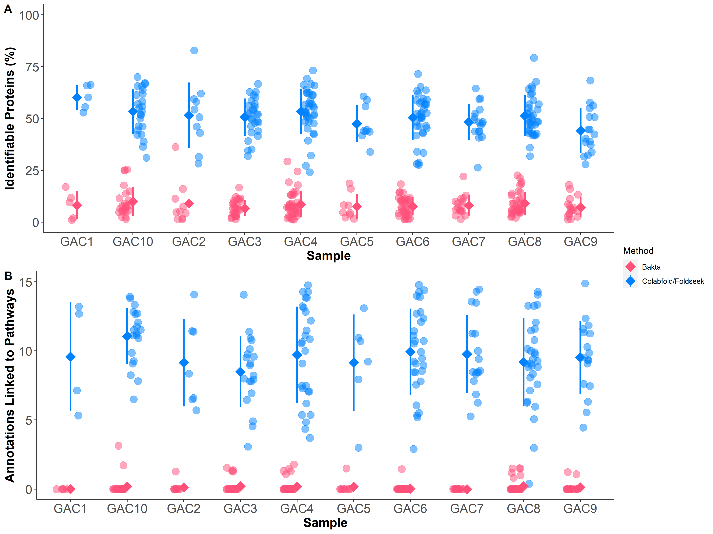
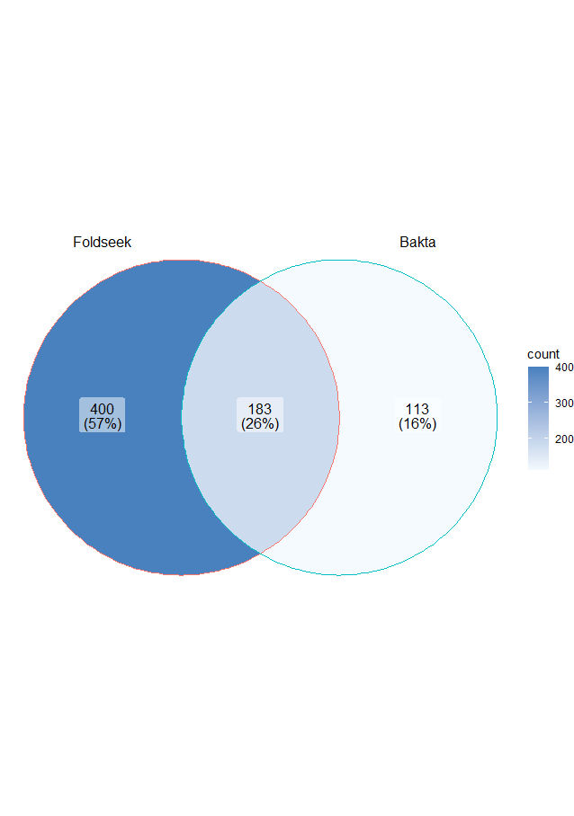
Big improvement overall
Henry Say

Slide 13
Why is this hard (part 1b)?
Moving and missing parts
Species can:
==
∆ abundance
∆ occurrence
Genes can:
==
∆ abundance
∆ occurrence
Dark matter
No genomes
No annotations
Notes:
Many more fragments than we can count

Slide 14

The next few slides may challenge firmly-held assumptions
tldr: all normalizations suck, some suck less than others

Slide 15
Why is this hard (part 2)
We don’t measure the parts directly
Gloor et al Front. Micro. 2017

Slide 16
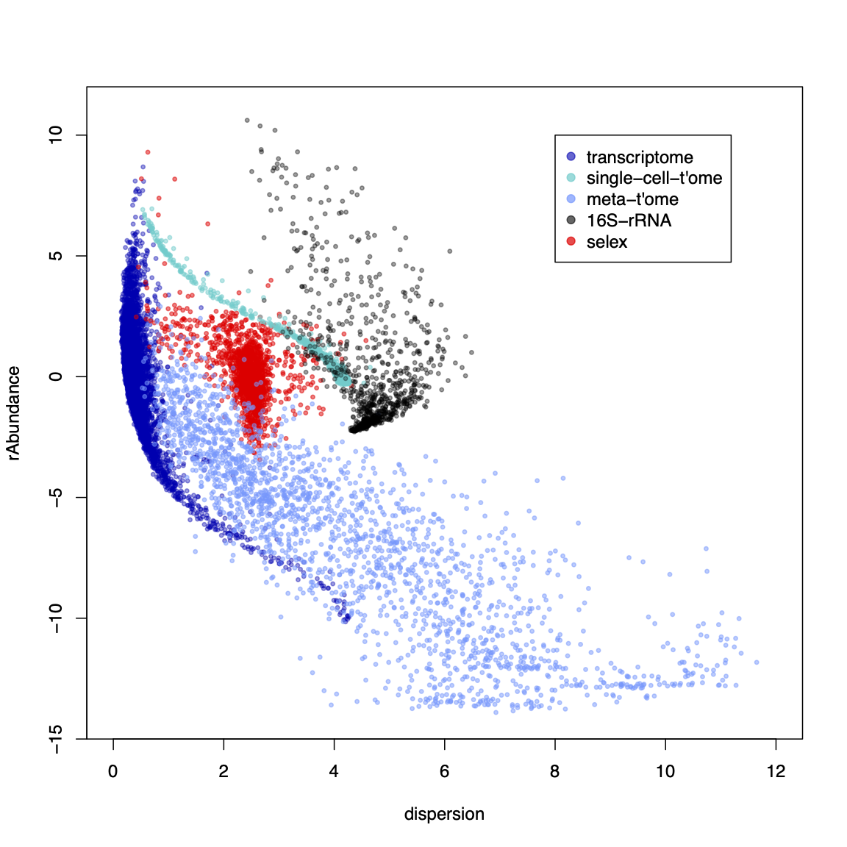
Why is this hard (part 3)?
Most tools are
designed for:
This
Maybe this
Not this
Or this
Definitely not this

Slide 17
We have problems
Sequencing data are probabilistic random samples
Almost always point observations or worse
Sequencing data are compositions
everything correlates with everything
the levels are confounded if the bacterial load (or mRNA content) differs between samples
our conclusions change when we include or exclude different sets of features
(Pearson 1896 Proceedings of the Royal Society of London 60, 489: Aitchison 1986 The Statistical Analysis of Compositional Data: Lovell 2015 PLoS Comput Bio,11:e1004075 )
Sequencing data are high-dimensional
Statistical analyses can be wildly optimistic
Shannon
Sequencing data are sparse
Therefore we need to estimate many of our values
Most of us are, at best, begrudgingly aware of the extent of the problems

Slide 18
Data as counts
Example 100 random sample sets
range=1800-2200
range= 8000-12000
range=450-550
🐯
🐞
👽
Gloor et al Front. Micro. 2017

Slide 19
As delivered by sequencing
Constant sum of 1000
Constant sum operations:
Count normalization
Rarefaction
Proportion
percentage, relative abundance
Sequencing
Simplex: one fewer dimensions than variables
Problems remain regardless of dimension
Gloor et al Front. Micro. 2017

Slide 20
Normalization is no help at all
Once data are on the simplex, they cannot be removed easily

Slide 21
Log-ratios for CoDa
Count
Sequencing
Simplex
27
853
66
740
112
216
clr(x) = [ log(x₁/g_{X}), log(x₂/g_{X}), … log(x_{D}/g_{X}) ]
X = [ x₁, x₂, … x_{D} ], g_{X} = geometric mean of X
Linearizes difference btw parts
Almost all normalization are ratios of some sort
“clr works better (UMAP, COR)“
Aitchison 1986. Stat. Anal. Comp Data
Pawlowsky-Glahn, 2015. Mod. Anal. CoDa
Notes:
Scale dependence - hence ‘normalization’
Correlation and covariation are unreliable
Addition and subtraction are not useful operations
Subsetting and aggregating are problematic
Sparse data is an issue

Slide 22
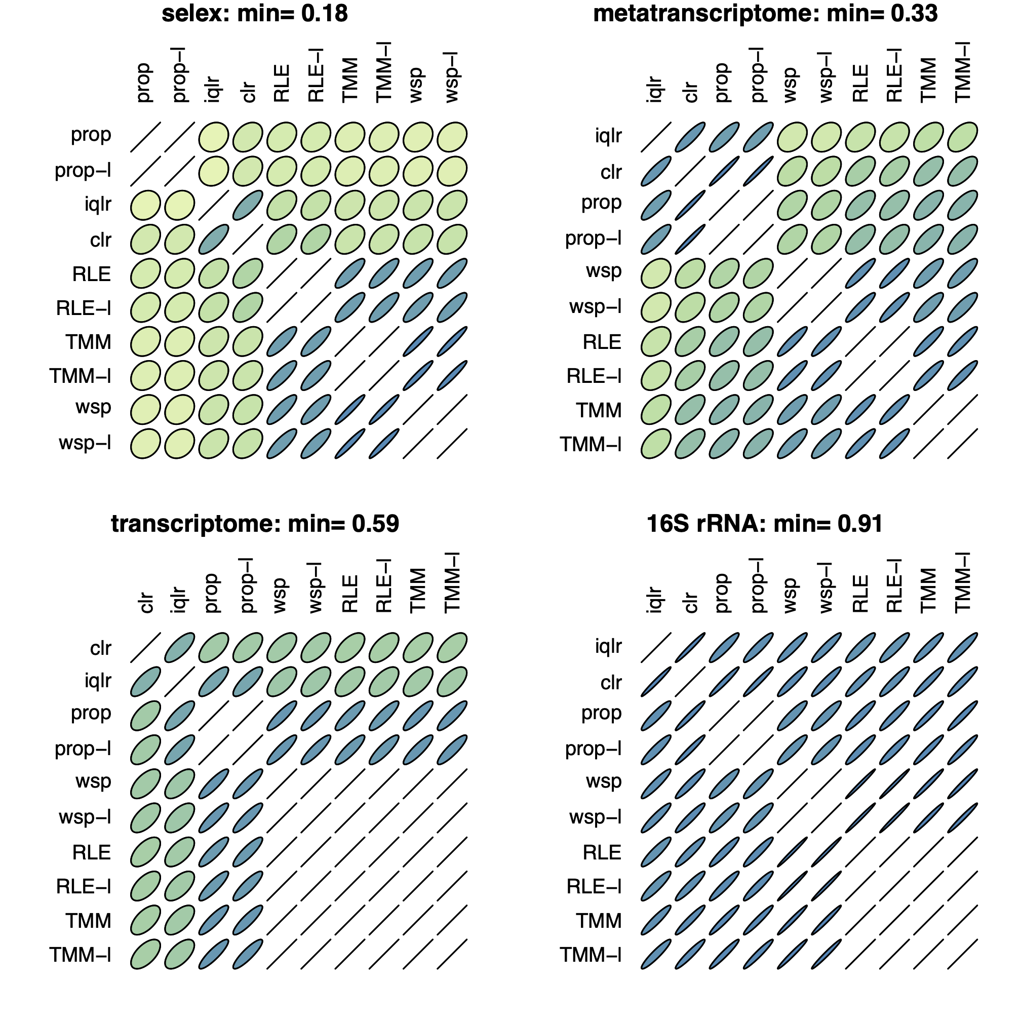
A note on correlation
Correlations observed vary greatly by normalization method
They become more concordant between normalization methods as the sample size increases
Selex N=7
MT N=12
TS N=48
16S N=160
SS N>1000, min>0.98
Skinnider:2019 Nat Meth

Slide 23
Meta-transcriptomics of an ecosystem
Difficult datasets
Sequencing all the mRNA in a collection of bacteria
May not know what genes are present or what they do
annotation in the era of structure prediction
Information about what is being made now
Often unbalanced
Different conditions can have different taxonomic compositions
Both absolute and relative abundance of the taxa and their transcripts can change
Relative abundance does not necessarily reflect environmental reality in sequencing data

Slide 24
Test dataset - bacterial vaginosis
Marked asymmetry in bacterial composition
H is predominantly Lactobacillus sp.
BV is mixed bag of anaerobes with L. iners
Marked asymmetry in functional composition
Asymmetrically sparse functions
Asymmetrically expressed functions
Group genes to functional level (SEED, KEGG, InterPro, etc)
If everything is different, then nothing is important
We must assume something is invariant

Slide 25
Datasets
Vaginal swab – treatment naïve (S)
Vaginal wash – BV treatment naïve, H post-metronidazole (W)
Deng et al. mSphere 2018
Annotate reads using same pipeline
VIRGO/SEED
Keep functions shared by both

Slide 26
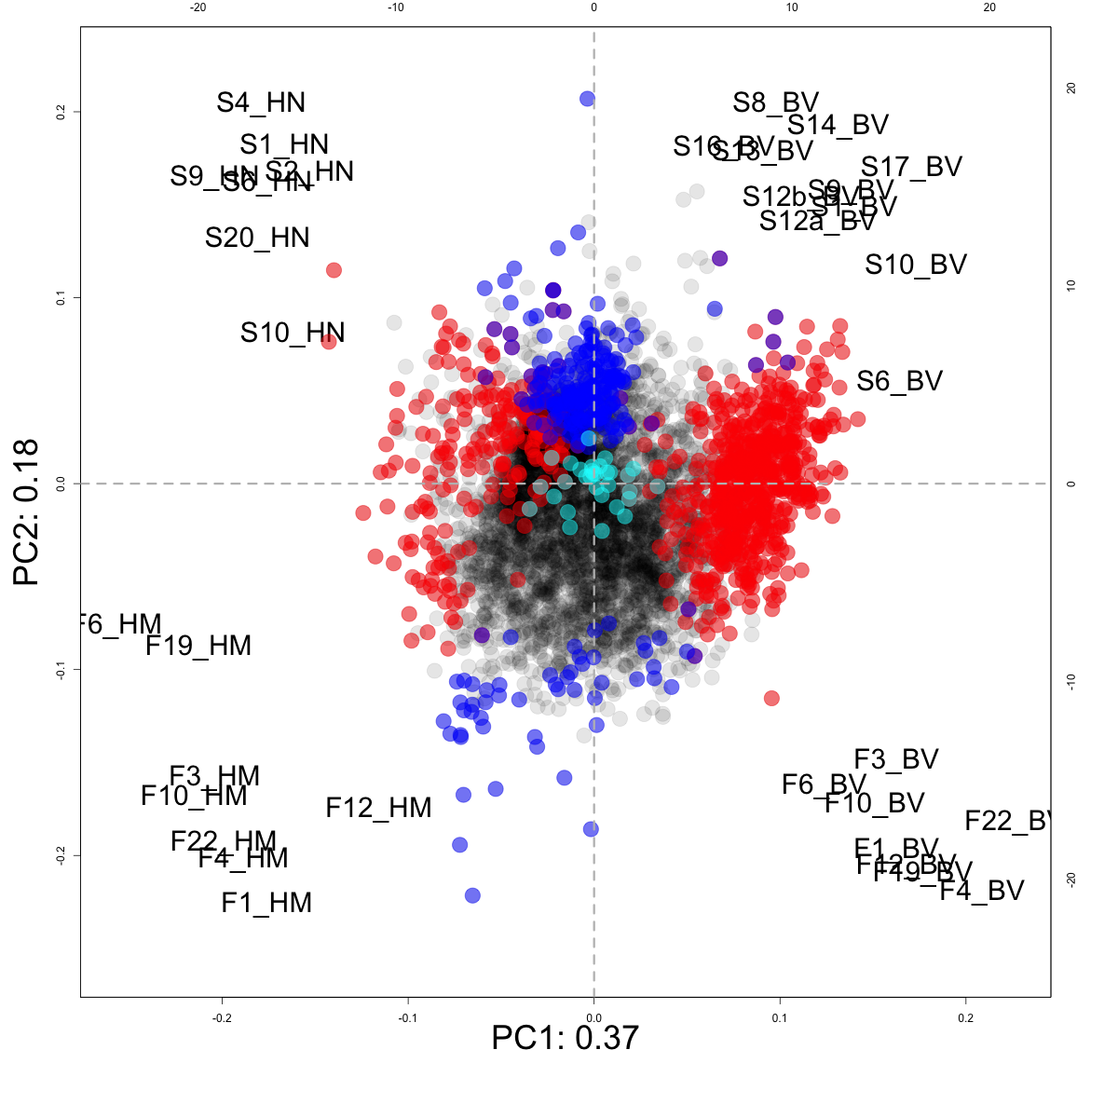
Distinct datasets:
Not different
LVHA
S vs F
H vs BV

Slide 27
BV dataset with edgeR tool
Bland-Altmann Plot
Each function is a point
Red are ‘DE’
DESeq2 no better
Obviously unbalanced dataset
What assumptions do not fit?
Majority invariant?
Dispersion ~ abundance?
Equal number of parts
0 is always 0
Notes:
Breaks the assumptions
Note the midpoint of the dataset is off the 0 line

Slide 28
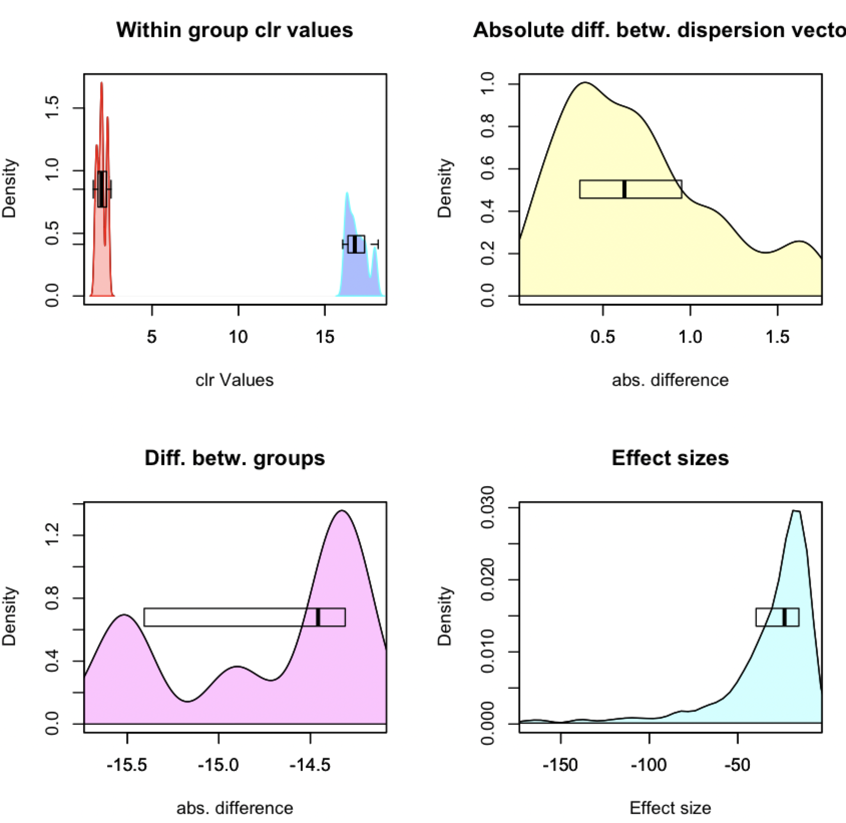
ALDEx2 under the hood
Convert counts to posterior probability distribution
Work on the distribution via log-ratio
Summarize E(val)
Directly accounts for sampling uncertainty
aldex.plotFeature()
CLR Distribution
Dispersion
Difference
Effect
https://bioconductor.org/packages/release/bioc/html/ALDEx2.html

Slide 29
Need to center the data
All
One
Robust midpoint variance
Low variance, high abundance
Median
Wu 2021 https://doi.org/10.1007/978-3-030-71175-7_17

Slide 30
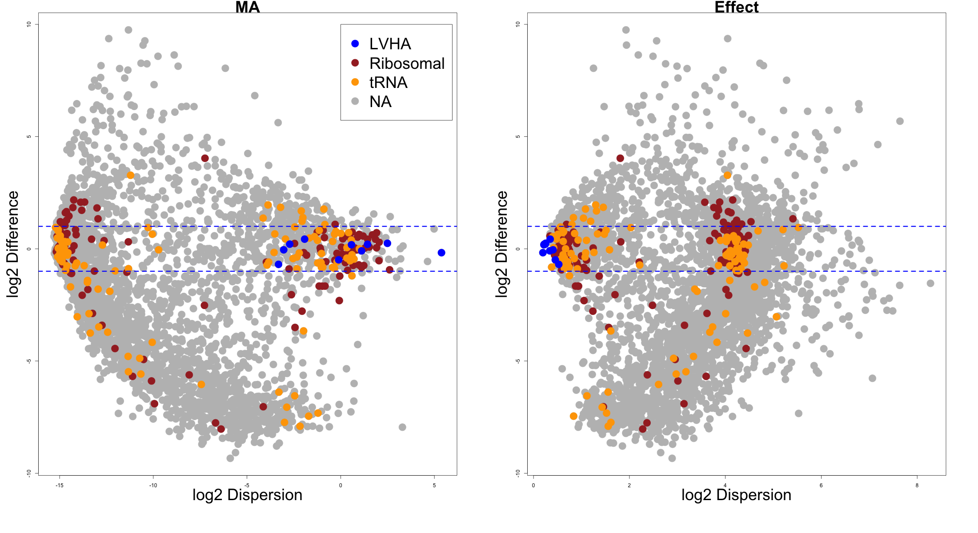
Housekeeping genes centred
Fernandes 2016 J Comp $ Graph Stats

Slide 31
Species from gene mappings

Slide 32
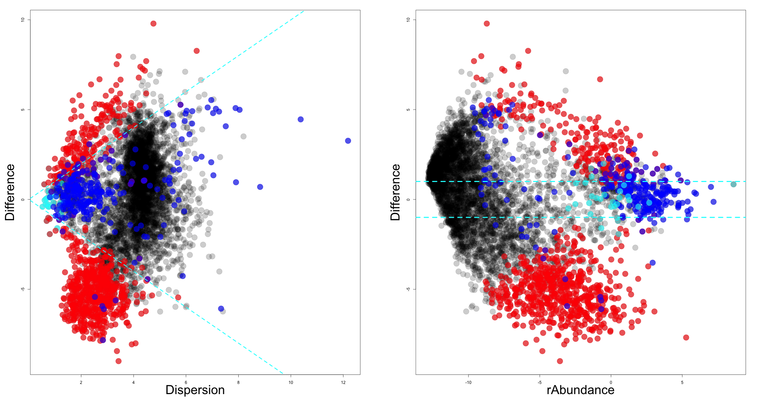
Effect (ALDEx2 E(glm))
Not different
LVHA
S vs F
H vs BV
Fernandes 2016 J Comp $ Graph Stats

Slide 33
BV gene level

Slide 34
BV Distinguishing features

Slide 35
Conclusions
Meta-transcriptomes are hard
Can at least get reproducible answers across datasets
Asymmetry in datasets is surprisingly common
Single-cell with different cell types similar but not as extreme
Large CNV will throw off the normalization
Proper centering is needed to prevent non-sensical answers
Manipulates the probability distributions using rules and tools of CoDa
Fully general approach that is internally consistent
ALDEx2 makes a probabilistic distribution of the data
Only assumption is random sampling
Somethings must be invariant but need not be many

Slide 36

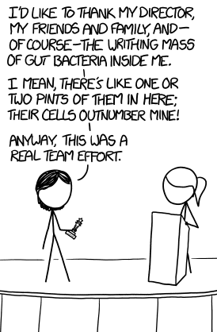


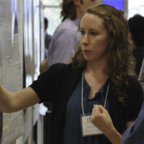




Andrew
Fernandes
Jean
Macklaim
Vera Pawlowsky-Glahn
Juan Jose Egozcue
Justin Silverman
philr
Tom Quinn
propr
Gregor Reid
Jeremy Burton
Daniel Giguere

Slide 37
Real sequence data are variable
Same features from same samples from the same library
Sequenced on different lanes
We should get comparable answers
We can estimate the variability by sampling Dirichlet instances
Multivariate, constrained balls in an urn
Fernandes, PLoS ONE 2013
Gloor, Aus J. Stat. 2016

Slide 38
Think of the 0s!
0 count can be real – or a non-detect
0 count is not 0 probability to detect the count
p_{i} = 0 is strong, invalid, assumption
[P_{i} > 0, P_{i} →0]
EBI Hinxton
Fernandes, PLoS ONE 2013
Gloor, Aus J. Stat. 2016

Slide 39
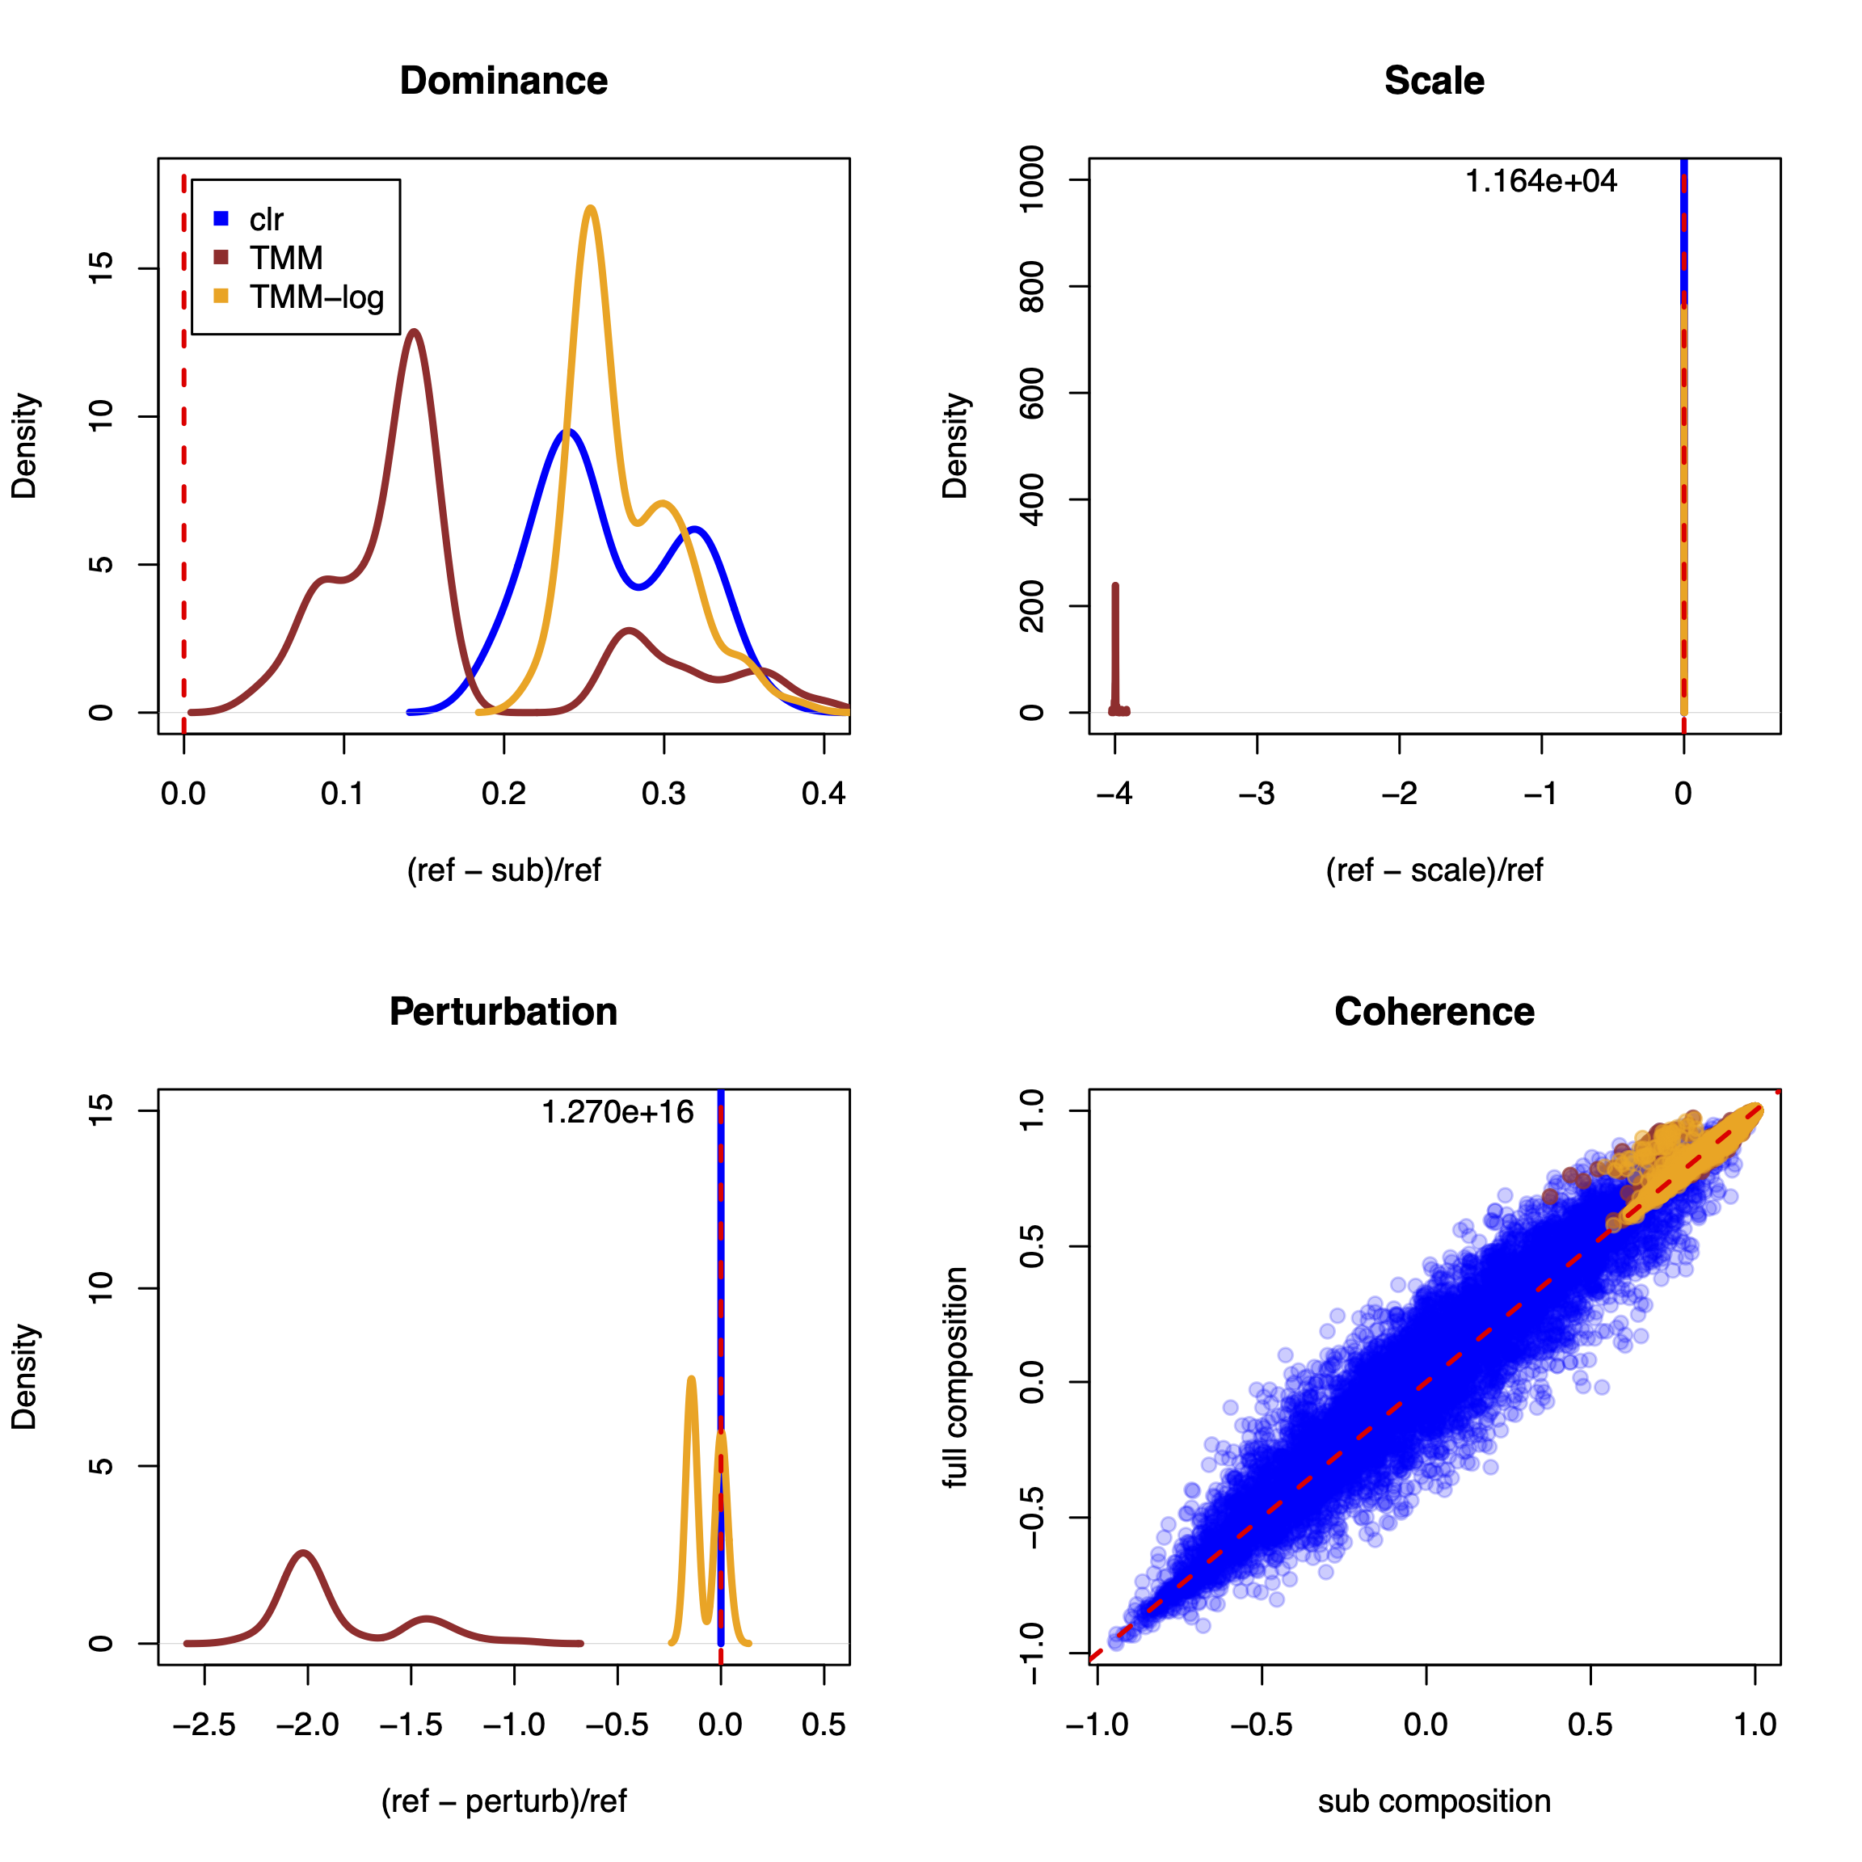
Normalization
TMM/RLE normalization does not:
Provide a common scale
Protect vs. perturbation (batch)
Give rational correlations in small datasets
TMM/RLE normalization does:
Usually provide consistent distances with filtered data
Log-ratios behave rationally under all scenarios – internal consistency with subsets
Gloor(2022) CRAN:aIc

Slide 40
ALDEx2 does and does not
Does not
Estimate parameters
Assume distributions
Pool information across features
Subset the data
‘Correct’ for sequencing depth
Does
Estimate probability distributions directly from data
Include a maximally uninformative prior distribution
Account for measurement error
Manipulate probabilities using rules and tools of CoDa
Report the mean ensemble value by default

Slide 41
ALDEx2: probabilistic CoDa
Group 1 Group 2
Generate posterior estimates of the data consistent with the observed data and the chosen prior(s)
Dirichlet instances
lr transform instances
Calculate test values on each instance
Correct for FDR
Report the expected value of each test for all instances
Dramatically reduces false positives with little or no loss of sensitivity for essentially any seq*omics dataset
Fernandes, et al. 2013. PLoS ONE
Fernandes, et al. 2014. Microbiome
Thorsen, Microbiome 2016
Notes:
Many more fragments than we can count

Slide 42
Genes by organism

Slide 43
H gene level

